Slide 1
Using Splunk/ELK for Auditing AWS/GCP/Azure Security Posture
By Rod Soto and José Hernandez

Slide 2
$Whoami
José Hernandez
Principal Security Researcher at Splunk. He started his professional career at Prolexic Technologies (now Akamai), fighting DDOS attacks against Fortune 100 companies perpetrated by “anonymous” and “lulzsec.” As a engineering co-founder of Zenedge Inc. (acquired by Oracle Inc.), José helped build technologies to fight bots and web-application attacks. He has also built security operation centers and run a public threat-intelligence service.
Rod Soto
Principal Security Research Engineer at Splunk. Worked at Prolexic Technologies (now Akamai), and Caspida. Cofounder of Hackmiami and Pacific Hackers meetups and conferences. Creator of Kommand && KonTroll / NoQrtr-CTF.

Slide 3
Security in the Cloud...
The cloud is prevalent and pervasive in all that we do.
Cloud providers are not invulnerable and attacks against them affect our lives.
As cloud adoption expands, there are an increasing number of new technologies and unknowns.
Cloud security is not an exact translation of inside-the-perimeter security.
Every provider has its own set of technologies, features, and security items.
While there are several cloud-security initiatives, it is still an ongoing effort.
There are a range of emerging tools designed to assess the cloud. We chose CS Suite because it helps analysts assess Azure, AWS, and GCP.

Slide 4
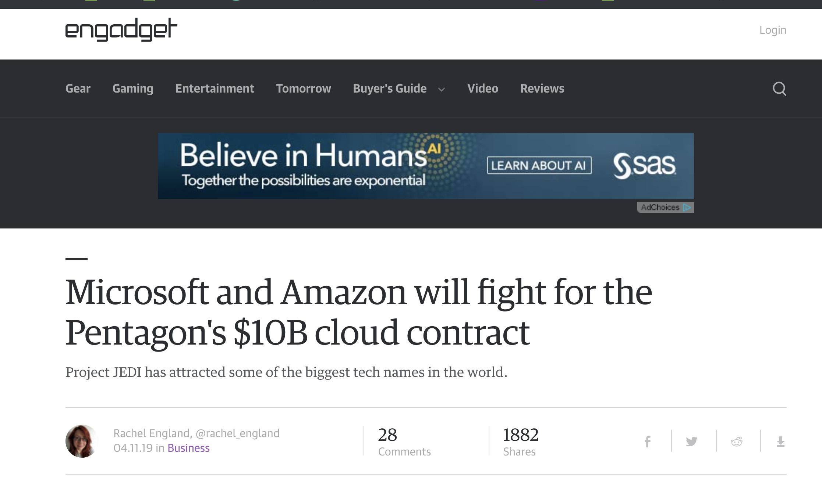
...Security in the Cloud

Slide 5
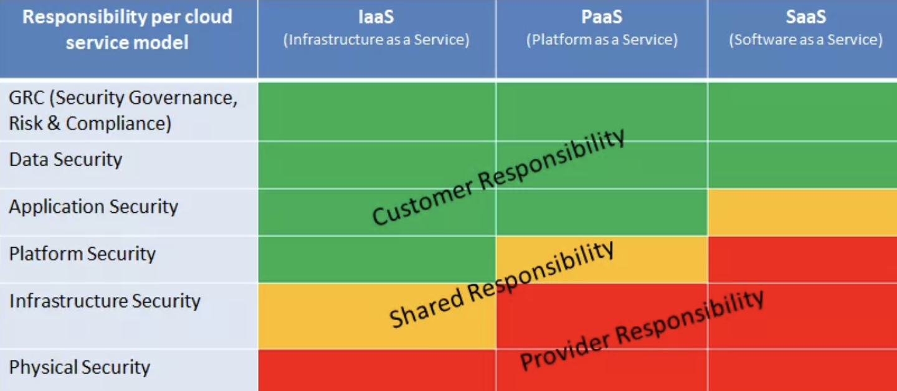
The Imaginary Line Between Provider And Customer

Slide 6
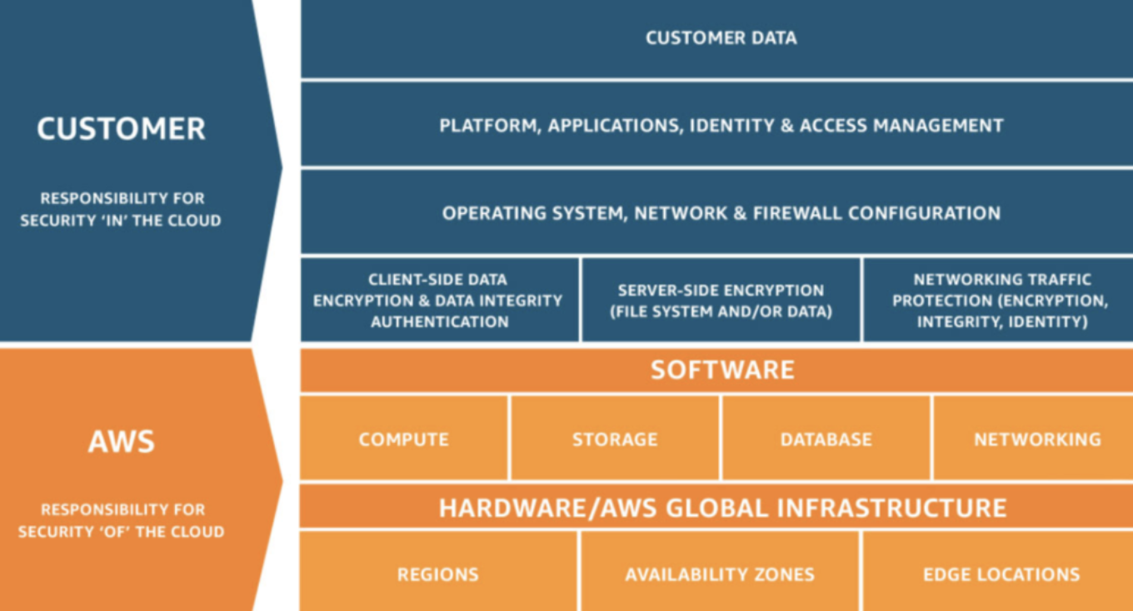
The Imaginary Line Is Not That Imaginary… AWS

Slide 7
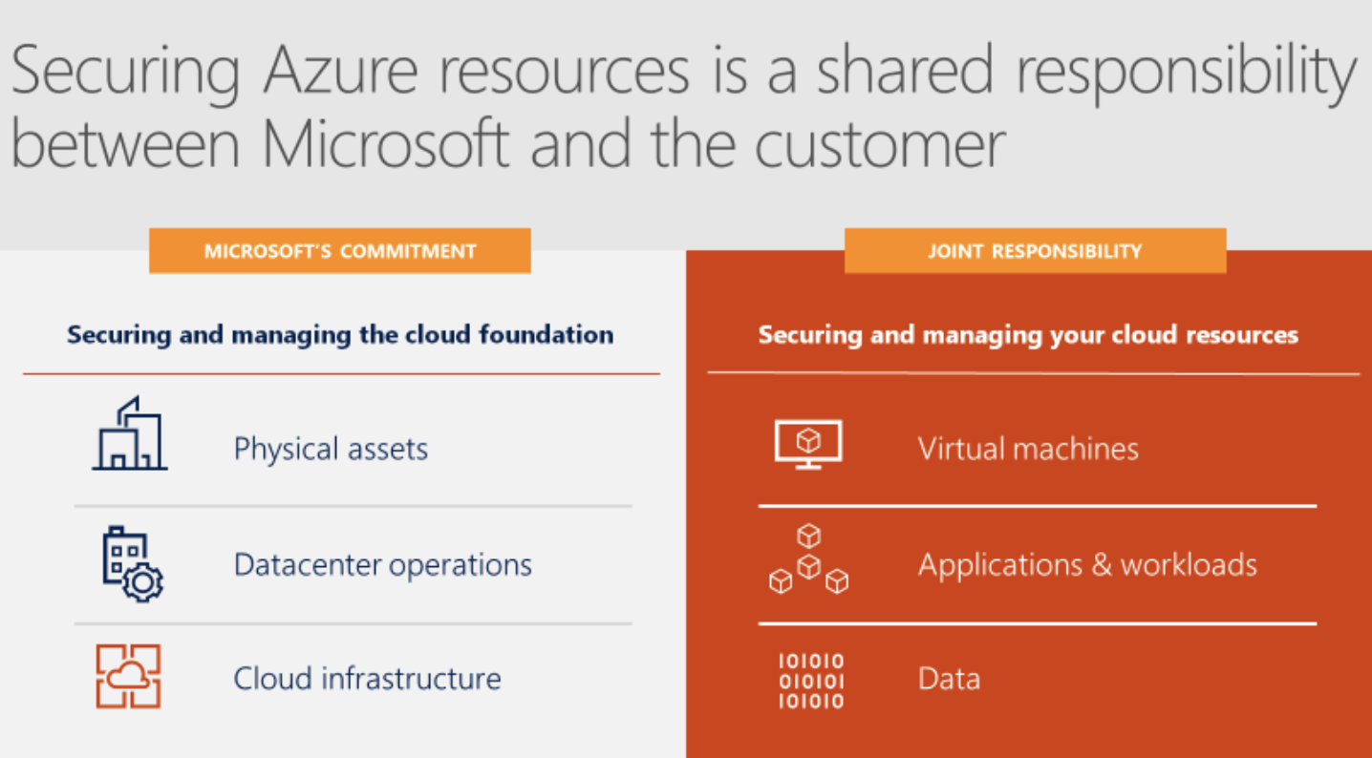
Azure

Slide 8
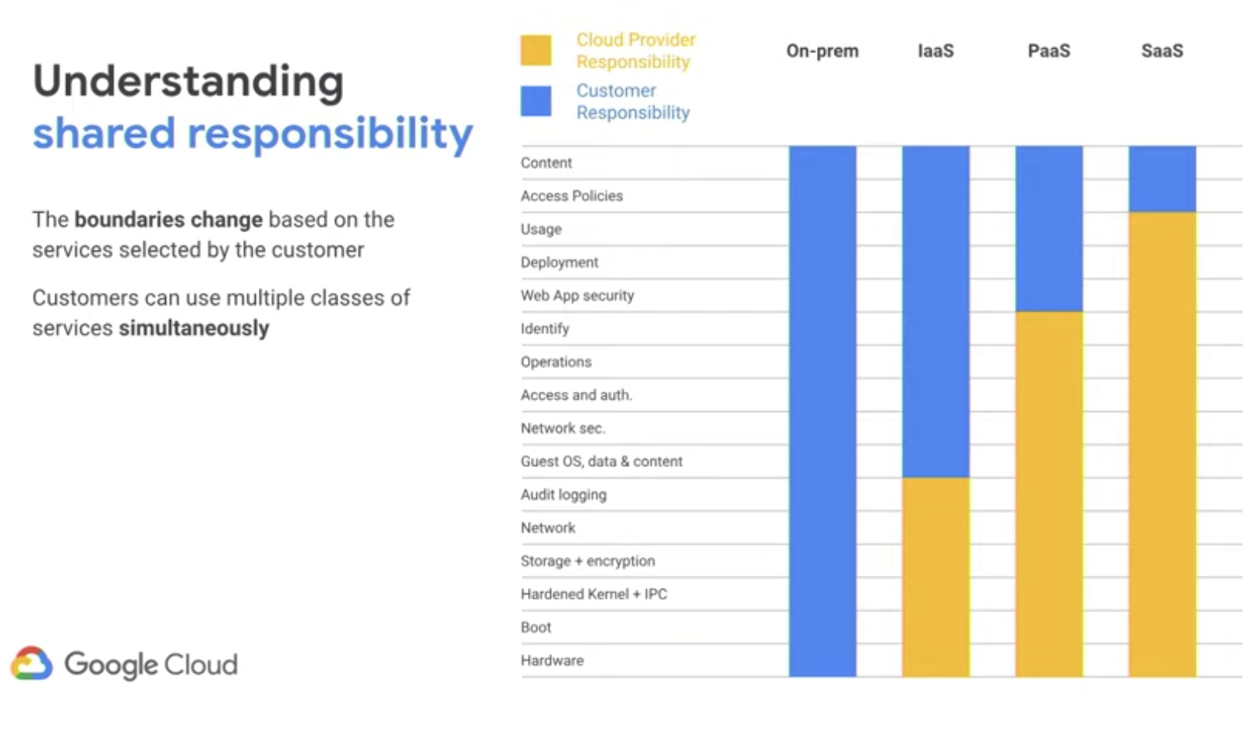
GCP

Slide 9
Cloud Attacks Highlights
Sony (2011): 77M users
ICloud (2014): The Fappening
CloudHopper: (2014 - 2016 - )(IBM, Fujitsu, NTT Data, Tata, HP, DXC, Dimension, CSC)
Ashley Madison: (2015) / AFF (2015/2016)
Equifax (2017): 143M customers
HBO (2017): 1.5 TB of data stolen, including unreleased GoT
Marriott (2018): 327M accounts
Kubernetes: CVE-2018-1002105 (PrivEsc)
Yup…2019 Capital One: 100M accounts

Slide 10
Main Cloud Attack Vectors CSA: "Treacherous 12"
Data breaches
Insufficient identity, credential, and access management
Insecure interfaces and application-programming interfaces (APIs)
System vulnerabilities
Account hijacking
Malicious insiders

Slide 11
Main Cloud Attack Vectors CSA: Treacherous 12
Advanced persistent threats (APTs)
Data loss
Insufficient due diligence
Abuse and nefarious use of cloud services
Denial of Service (DoS)
Shared technology vulnerabilities

Slide 12
Main Targets of Cloud Attacks
Users: ATO, key exfil, phishing
Providers: AZ, AWS, GCP
Admins: Like Domain Admin, they have access to all
Resources: Cryptomining, DDoS for rent
Data: Everyone's private life and work information
Third parties Partner or co-tenant gets hacked, actor pivots to your cloud, attacks affecting IdP

Slide 13
DevOps Attack Surface (CI/CD Pipeline)
Source code repository: Bitbucket, Beanstalk, Github, Gitlab, SVN, S3 buckets
CI/CD platform: TravisCI, Jenkins, CircleCI, Gitlab
Container repository: Docker, Vagrant
IaaS Provider: Kubernetes flavor, OpenStack (this may also be local in some private, hybrid environments)
IaC Ansible, Terraform, Chef, Cloudformation

Slide 14
Main Cloud Attack Surface Segments
Compute backend,
distributed processing
CLAN/CWAN
Databases
SQL/NOSQL
Storage (block, object, file)
Internet/intranet client
HTTP, API, web services, web sockets

Slide 15
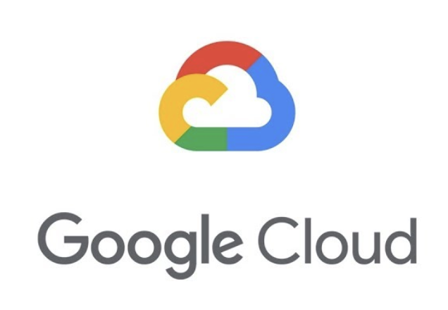


Can We Create Common Criteria For Cloud Security?

Slide 16
Common Criteria For Cloud Security
Network: External access, VLAN/VWAN, VPN, routing
Security: CIA → heavy emphasis in IAM, encryption, and FWs
Compute: Artifacts such as virtual machines, containers, apps, microservices
Database: SQL, NOSQL
Storage: Basically buckets and file type storage (block, object, file)
Management: Kubernetes flavor, logging setup, Management access

Slide 17
Common Criteria for Cloud Security Audits
Compute
AWS: EC2, Lightsail, Lambda, Elastic Beanstalk, ECS, EKS, Batch, ECR, Kubernetes
Azure: Virtual machines (VMs), load balancers, app services, batch, Mesh, disks, Kubernetes
GCP: VM Instances, disks, snapshots, images, TPUs, metadata, zones, Kubernetes, "big data"
Network
Database

Slide 18
Common Criteria for Cloud Security Audits
Management
AWS: Console, CloudTrail, Config, OpsWorks, Systems Manager, CloudFormation, Kubernetes
Azure: Console, Monitor, Advisor, activity log, metrics, manage applications, solutions, Kubernetes
GCP: Console, StackDriver, audit logs, cloud tasks

Slide 19
Common Criteria for Cloud Security Audits
Storage
AWS: S3, EFS, FSx, S3 Glacier, storage gateway, AWS backup
Azure: Data Box, Storage explorer, StorSimple, Data Lake Storage
GCP: Bigtable, Buckets, DataStore, FireStore, Filestore, Spanner, Memorystore

Slide 20
Common Criteria for Cloud Security Audits
Security
AWS: IAM, Resource Access Manager, Secrets Manager, GuardDuty, AWS SSO, Certificate Manager, Key Management Service, Dir Service, WAF & Shield, Security Hub
Azure: Azure AD, Security Center (encryption, FW, WAF, etc.), Azure Vault
GCP: Security Command Center, Cloud Identity-Aware Proxy, Access Context Manager, VPC, Binary Authorization, Data Loss Prevention, cryptographic keys, Access Approval, Web Security Scanner

Slide 21
Common Criteria for Cloud Security Audits
Network
AWS: VPC, CloudFront, Route53, API Gateway, Direct Connect, AWS App Mesh, AWS Cloud Map, Global Accelerator
Azure: Virtual Networks, Load Balancers, DNS zones, CDN, Traffic Manager, ExpressRoutes, IPs, route tables/filters, Virtual WANS, Network Interfaces
GCP: Virtual Private Cloud network, Network Services, Hybrid Connectivity, Network Service Tiers, network security

Slide 22
Common Criteria for Cloud Security Audits
Database
AWS: RDS, DynamoDB, ElastiCache, Neptune, Amazon Redshift, Amazon QLDB, Amazon DocumentDB
Azure: SQL DB, Azure DB for PostGres/MariaDB, Redis, SQL Elastic pools, Cosmos DB
GCP: Datastore, BigQuery, MongoDB, PostgreSQL

Slide 23
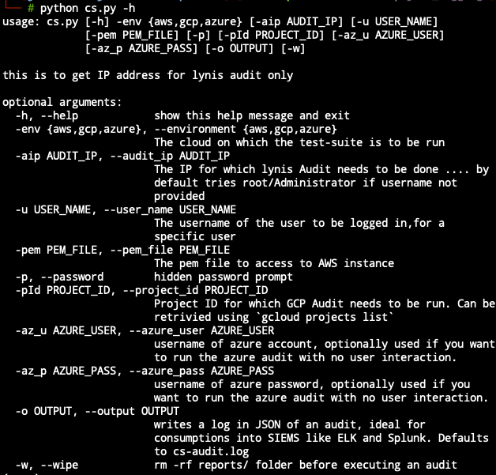
Enter Cloud Security Suite
One-stop tool for auditing the security posture of AWS/GCP/Azure infrastructure
Gathers and presents unified information from the following tools:
GScout
Scout2
Prowler
Lynis
Azure Audit template
Notes:
Runs a step of tools to scan for common errors, and vulnerabilities of all cloud providers, runs over 100+ checks for misconfigurations down to common vulnerabilities and best practices

Slide 24
Installation
Github https://github.com/SecurityFTW/cs-suite
We modified the original project to produce output logs that can be ingested by major SIEM frameworks.
You will need CLI tools, accounts with read privileges, and an API token for authentication, in some cases.
Your vision may vary, depending on segmented resources and organizational architecture.
The tool, however, presents a nice report category interface.
Notes:
Its a simple process of virtualenv, plus install deps from requirements.txt and finally use cs.py problem is getting each provider auth configured correctly

Slide 25
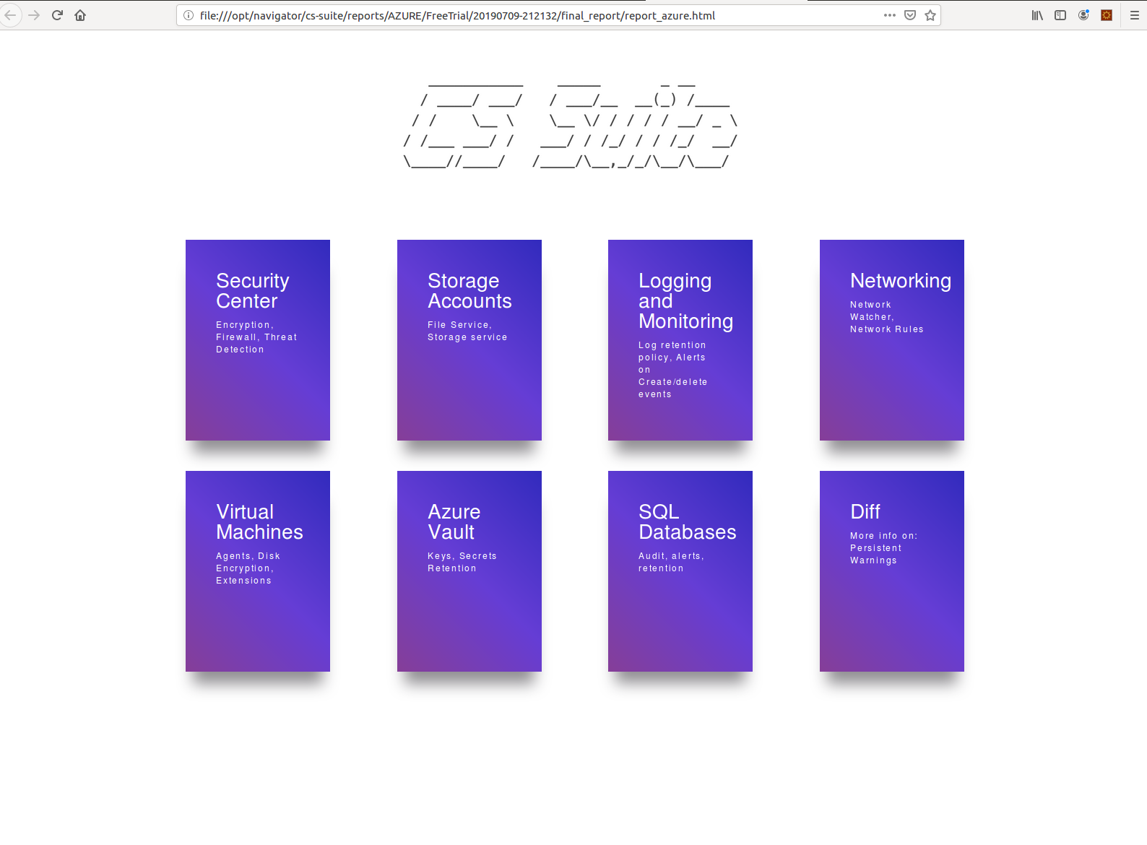
Azure Security Benchmarks

Slide 26
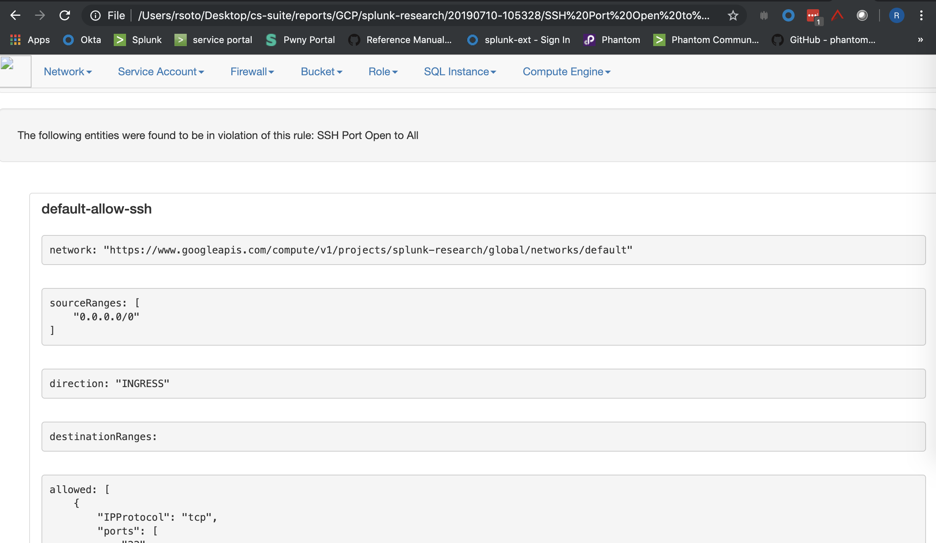
GCP Security Benchmark

Slide 27
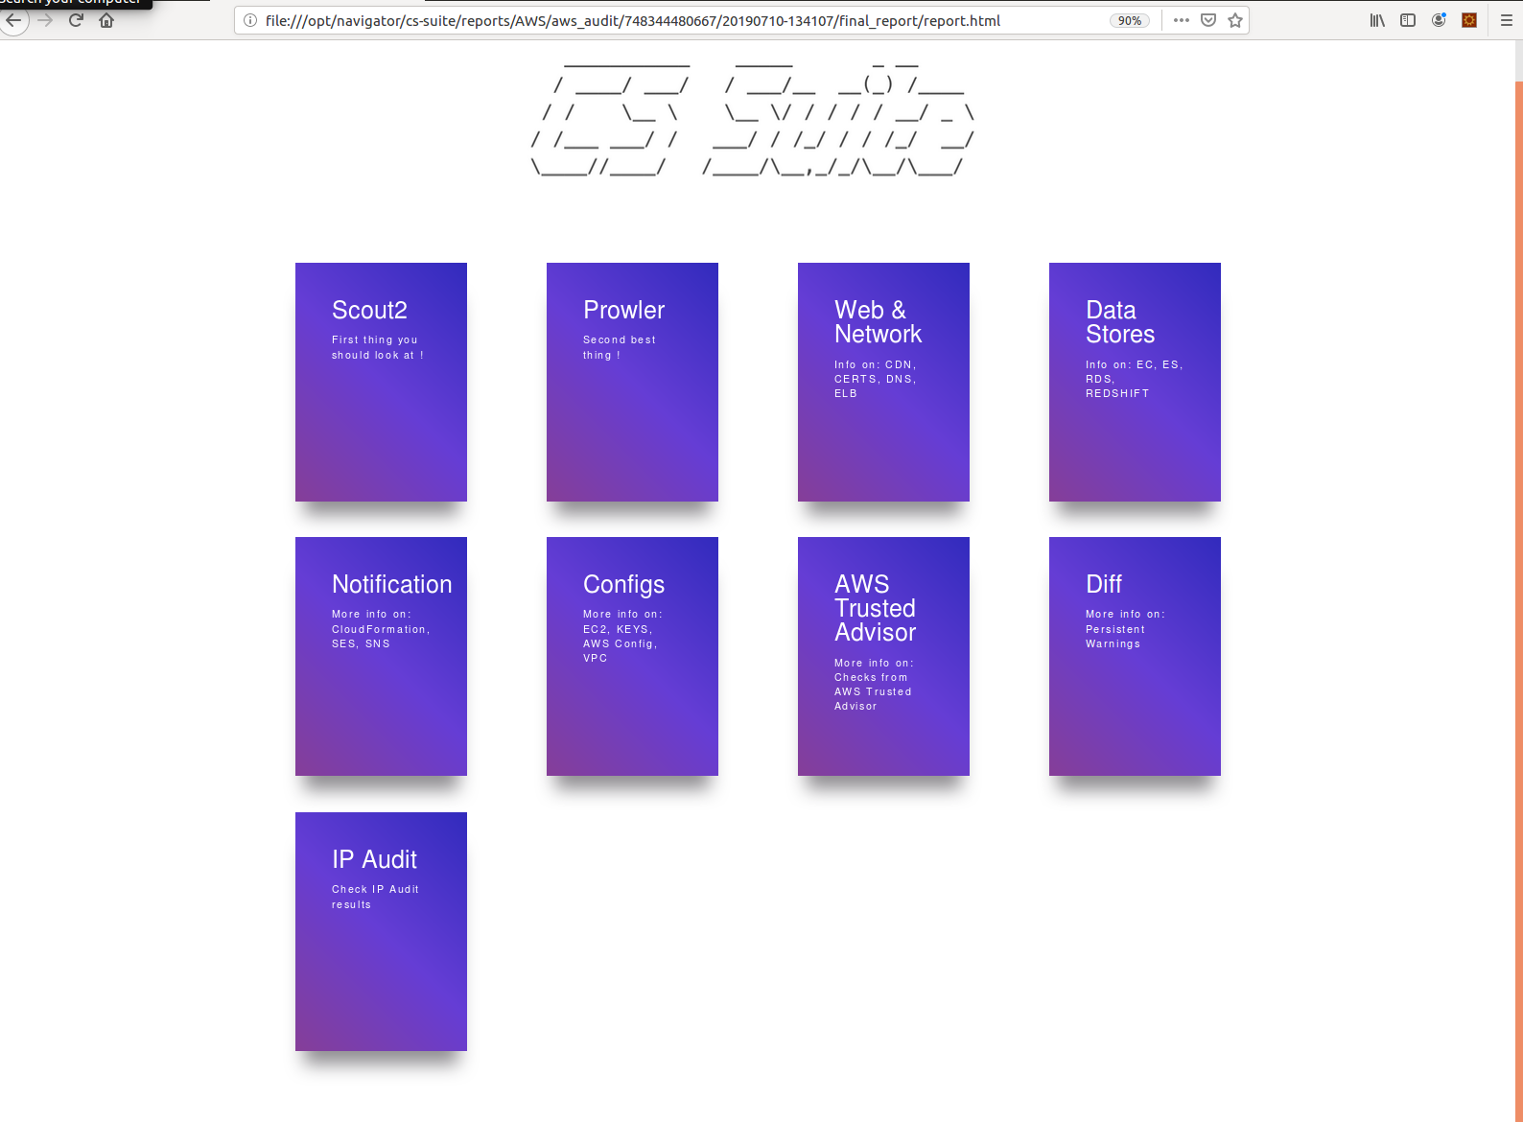
AWS Security Benchmarks

Slide 28
The Challenge Of Getting All These Sources Together...
Logging in the cloud costs $ and requires time for setup. It is not provided by default (CloudTrail, Stackdriver, Azure Monitor, GCP Stackdriver).
A log indexing and data streaming pipeline infrastructure (Splunk/ELK) needs to be present.
Architecture of streaming and storage
A framework that allows analysis and further knowledge operation (basically SIEM).
Most of the cloud providers have JSON output. Not all monitoring logs are in JSON file, but enough to get a first comprehensive approach.

Slide 29
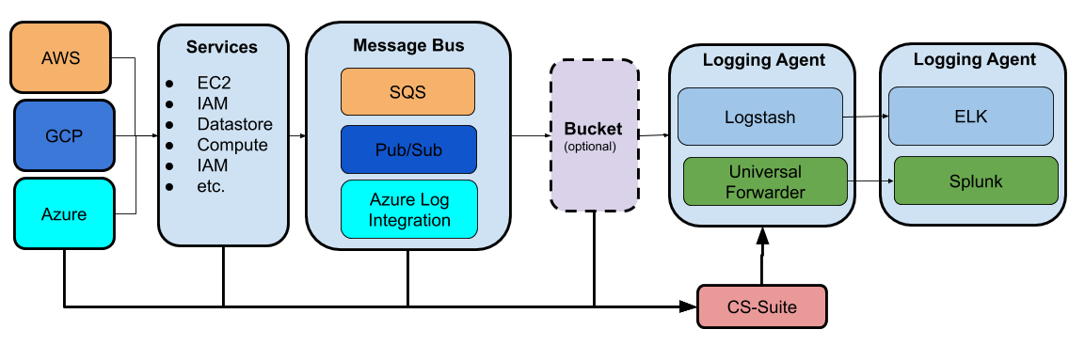
Architectural Diagram

Slide 30
Integration with popular SIEMS Splunk/ELK
Based on the common criteria items we can create knowledge objects that can allow the analyst have a better vision on cloud security resources
Things such as dashboards, reports can help analysts make sense of the onslaught of logs coming from such disparate sources
We can then create alerts, lookups and even SOAR playbooks that can help us automate from the onslaught of logs.

Slide 31
ELK

Slide 32
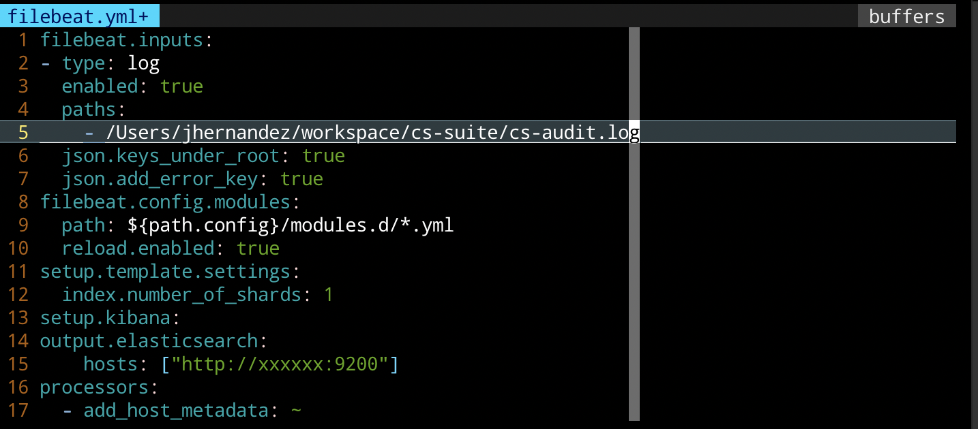

Slide 33
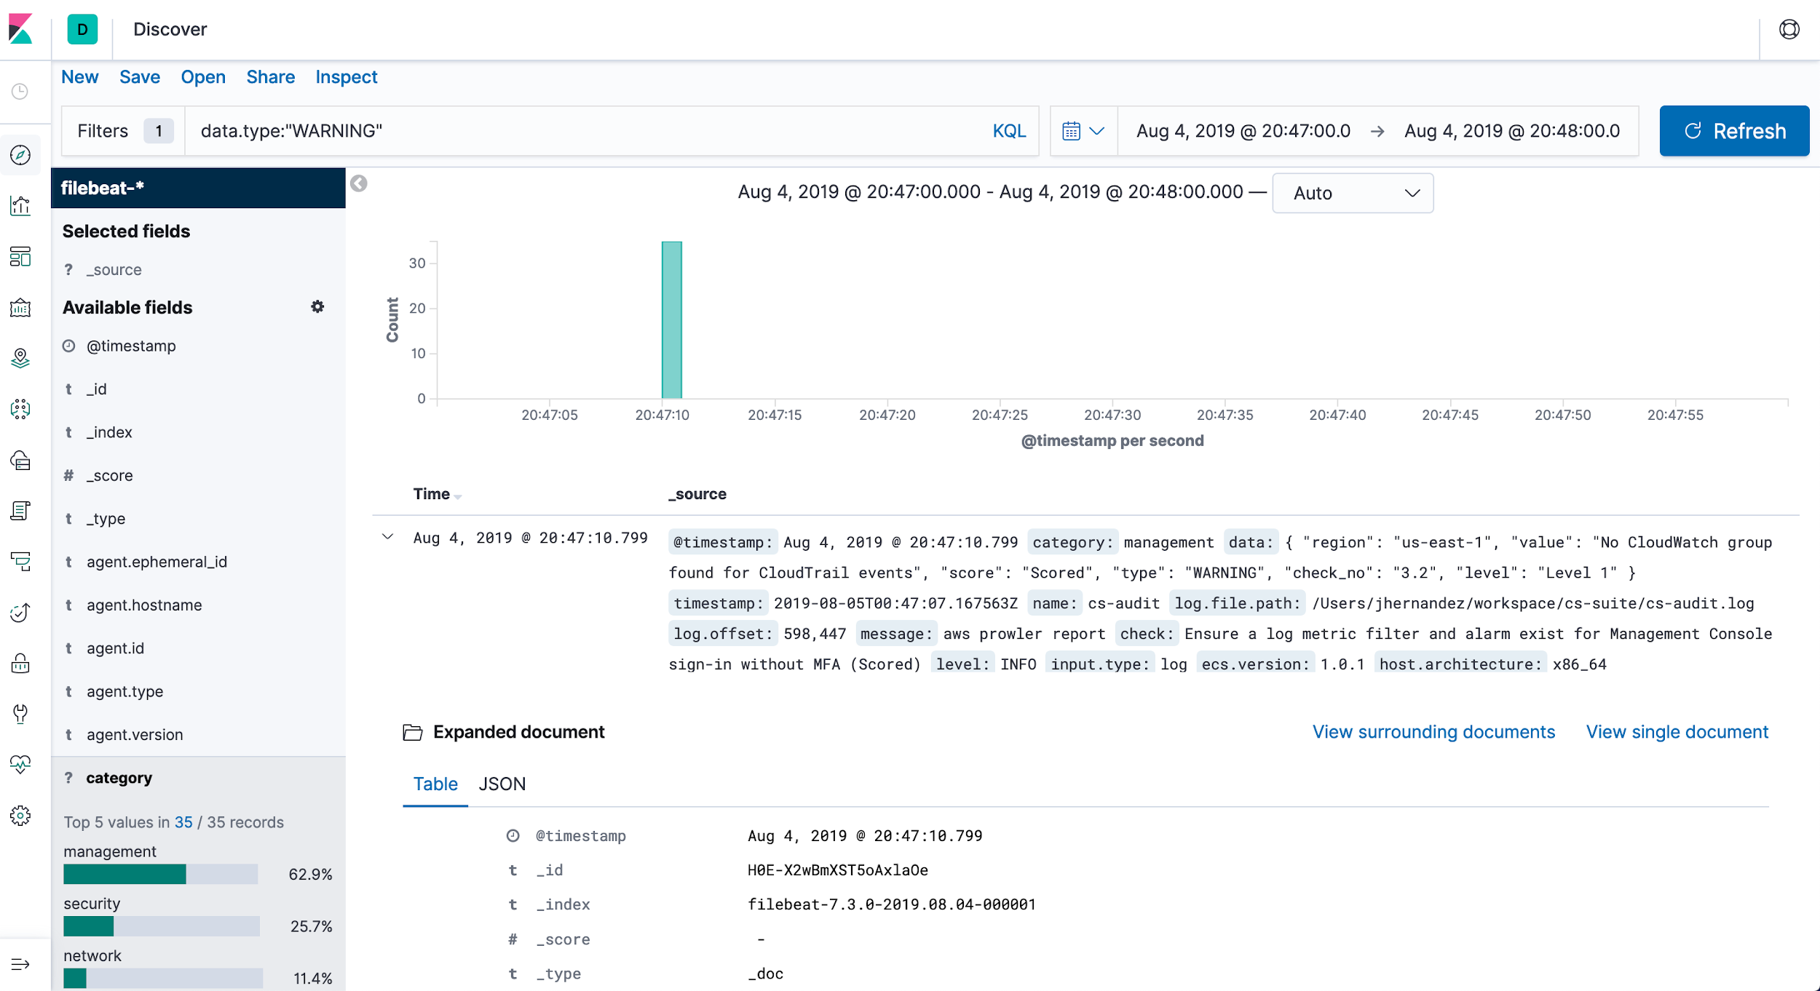
ELK
Logstash

Slide 34
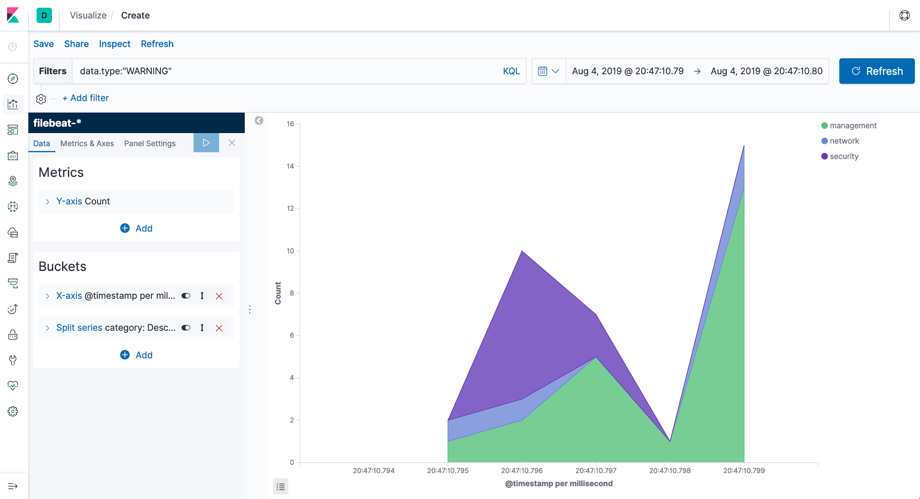
Kibana slide

Slide 35
Splunk

Slide 36
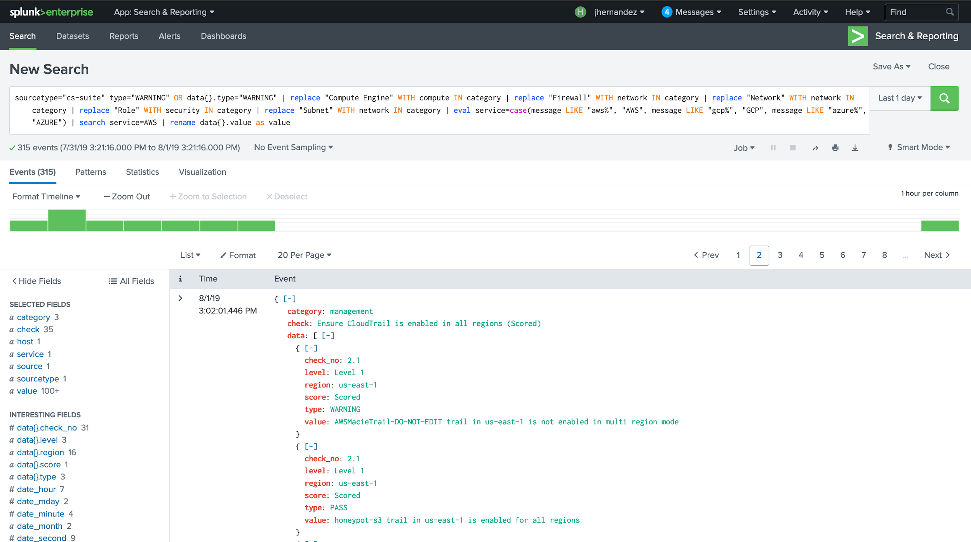
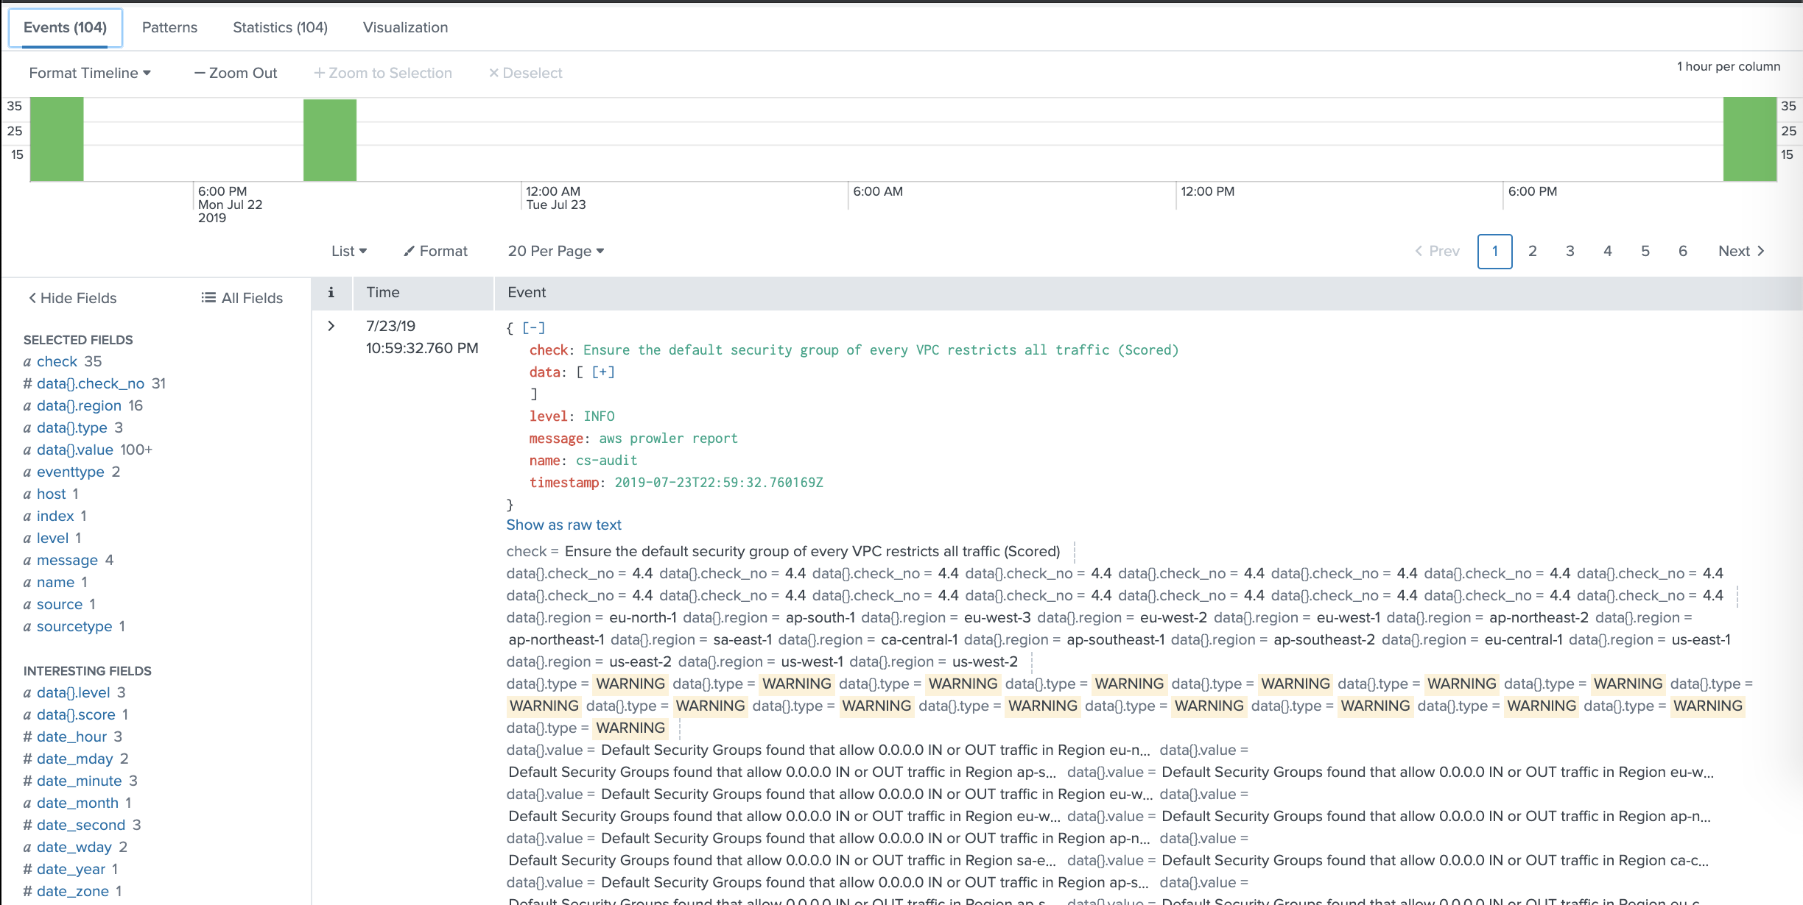
SPLUNK

Slide 37
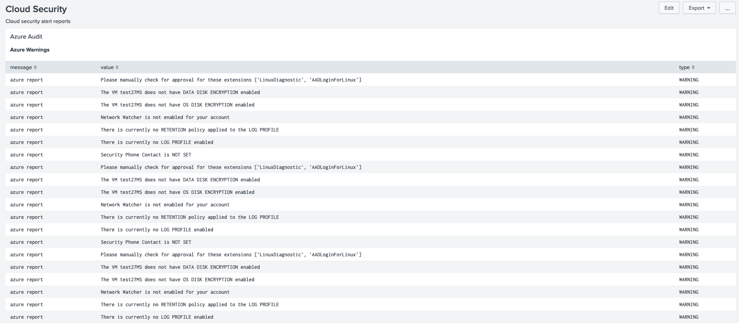

Slide 38
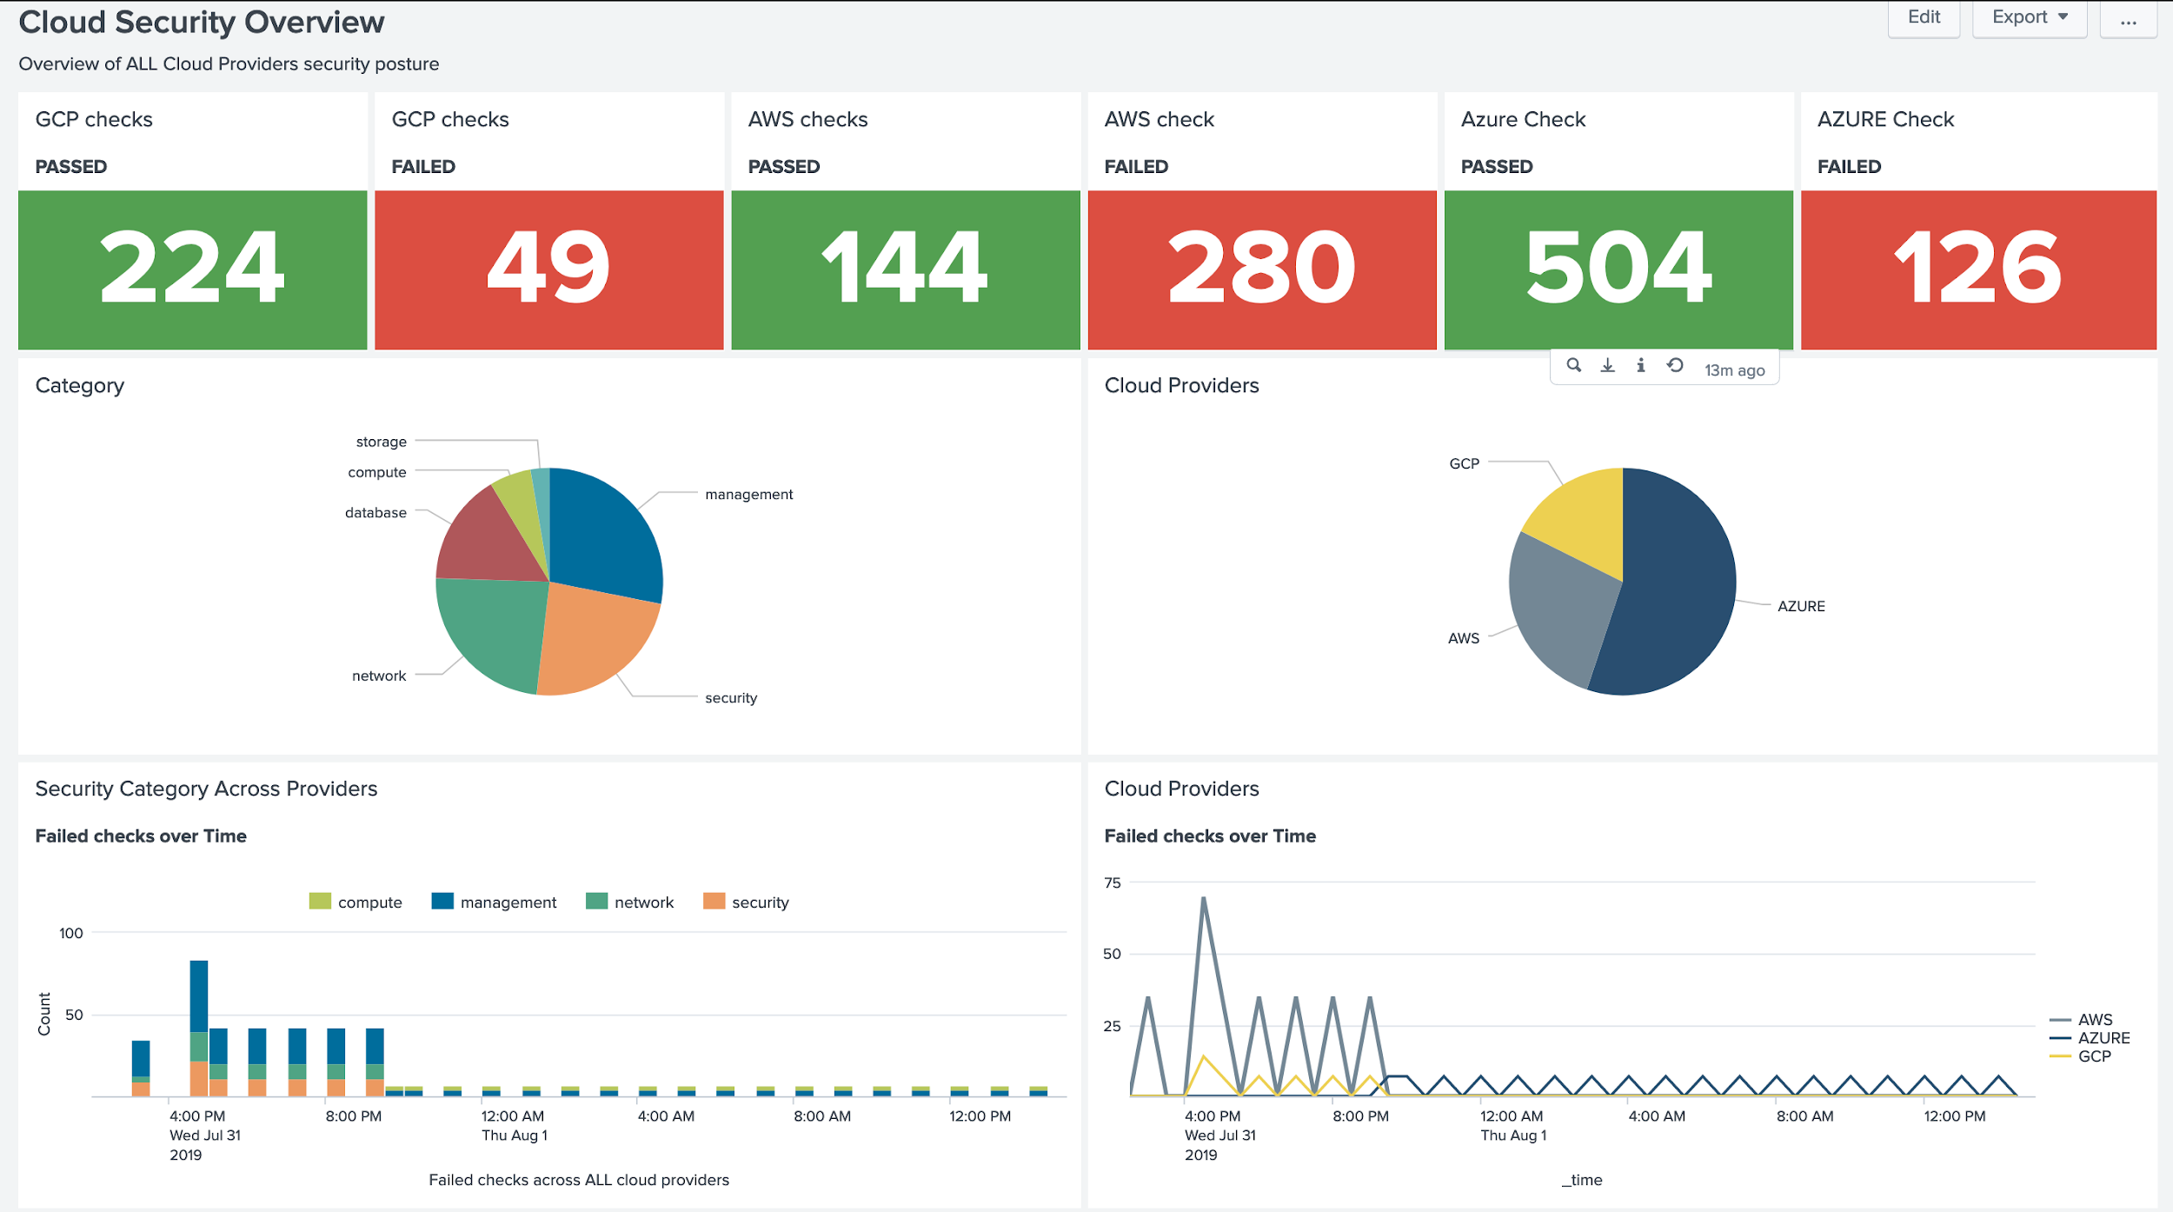
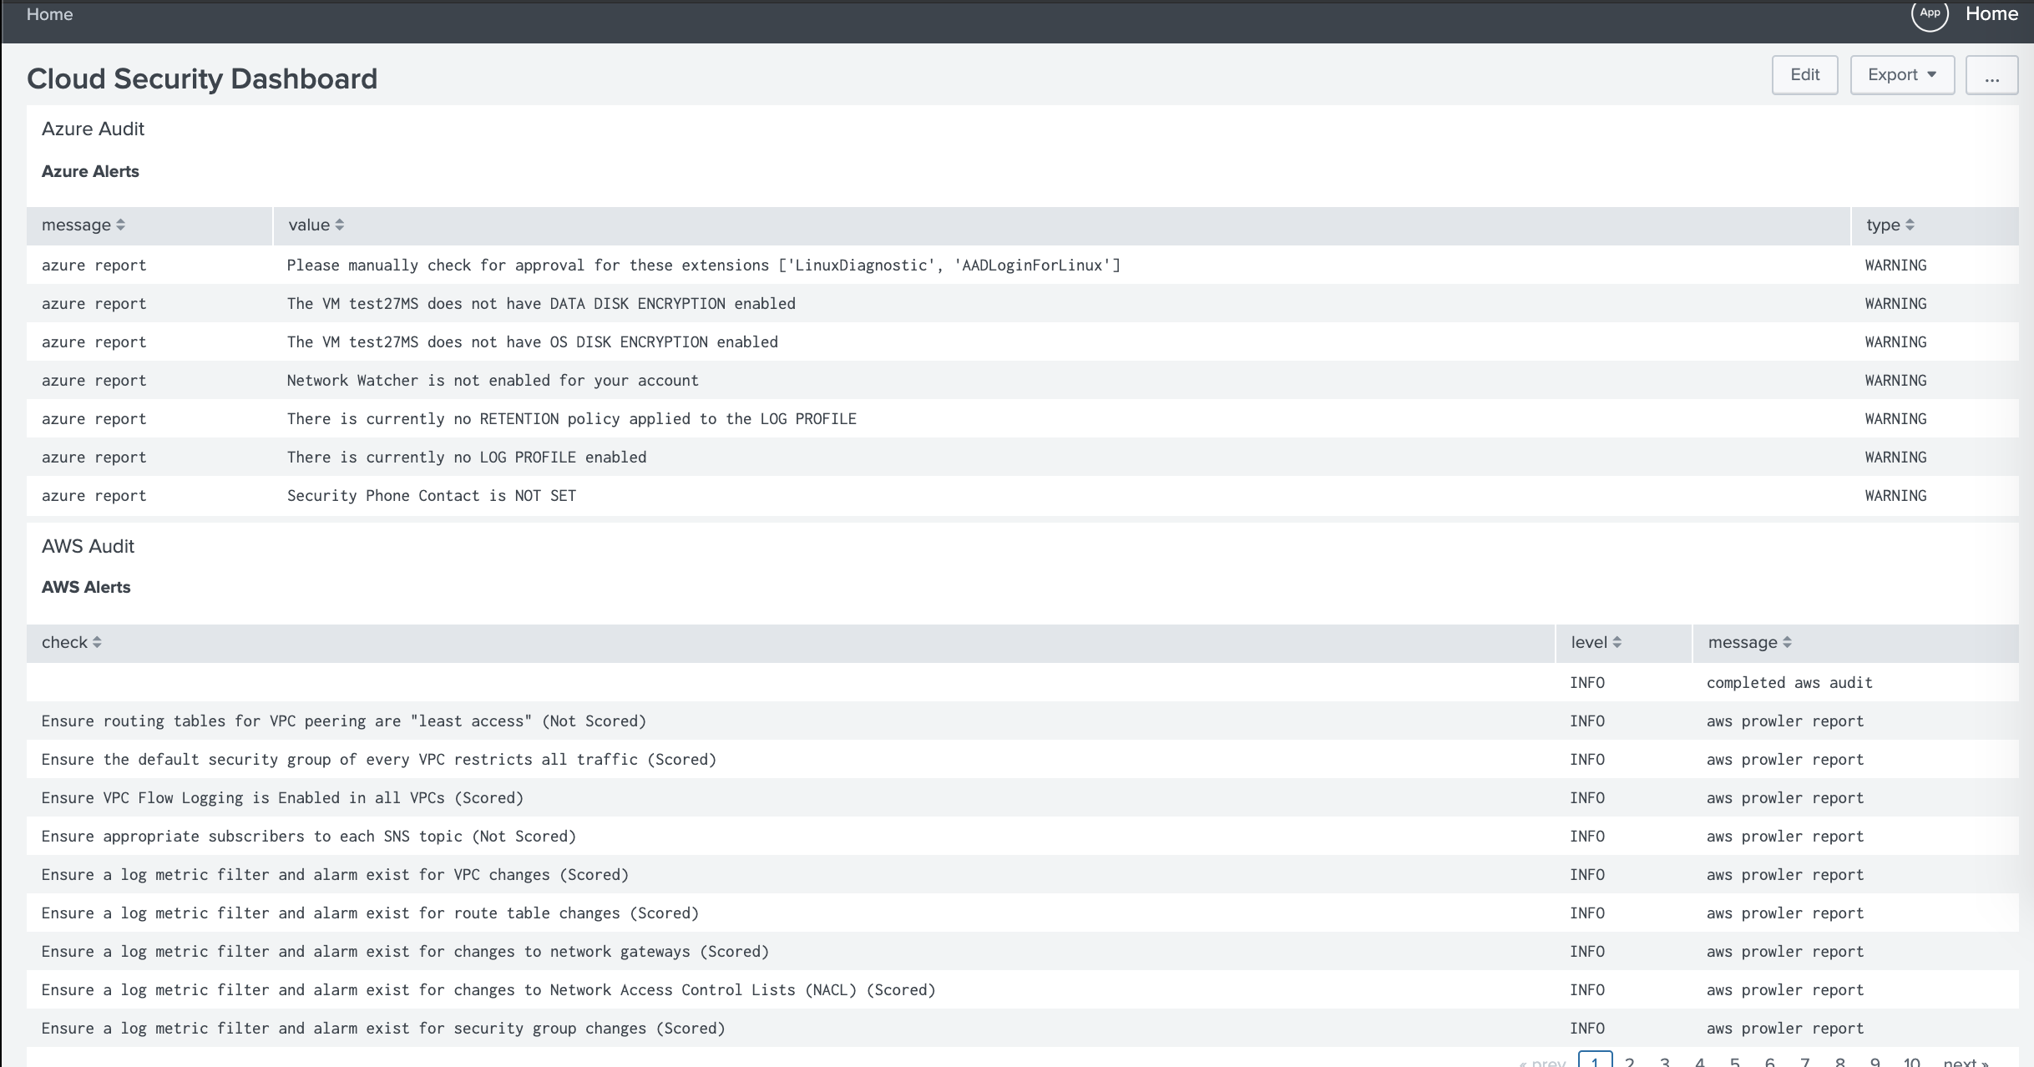
SPLUNK

Slide 39
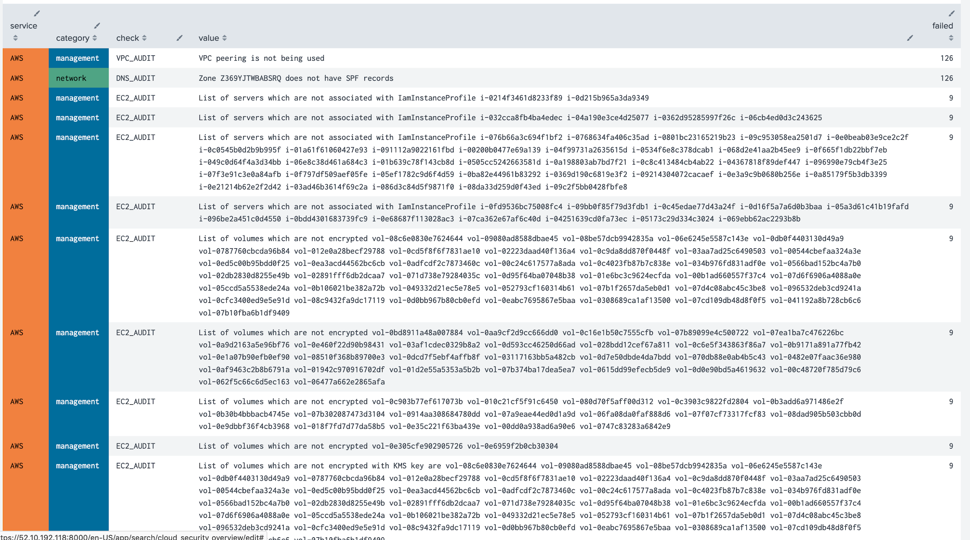
SPLUNK

Slide 40
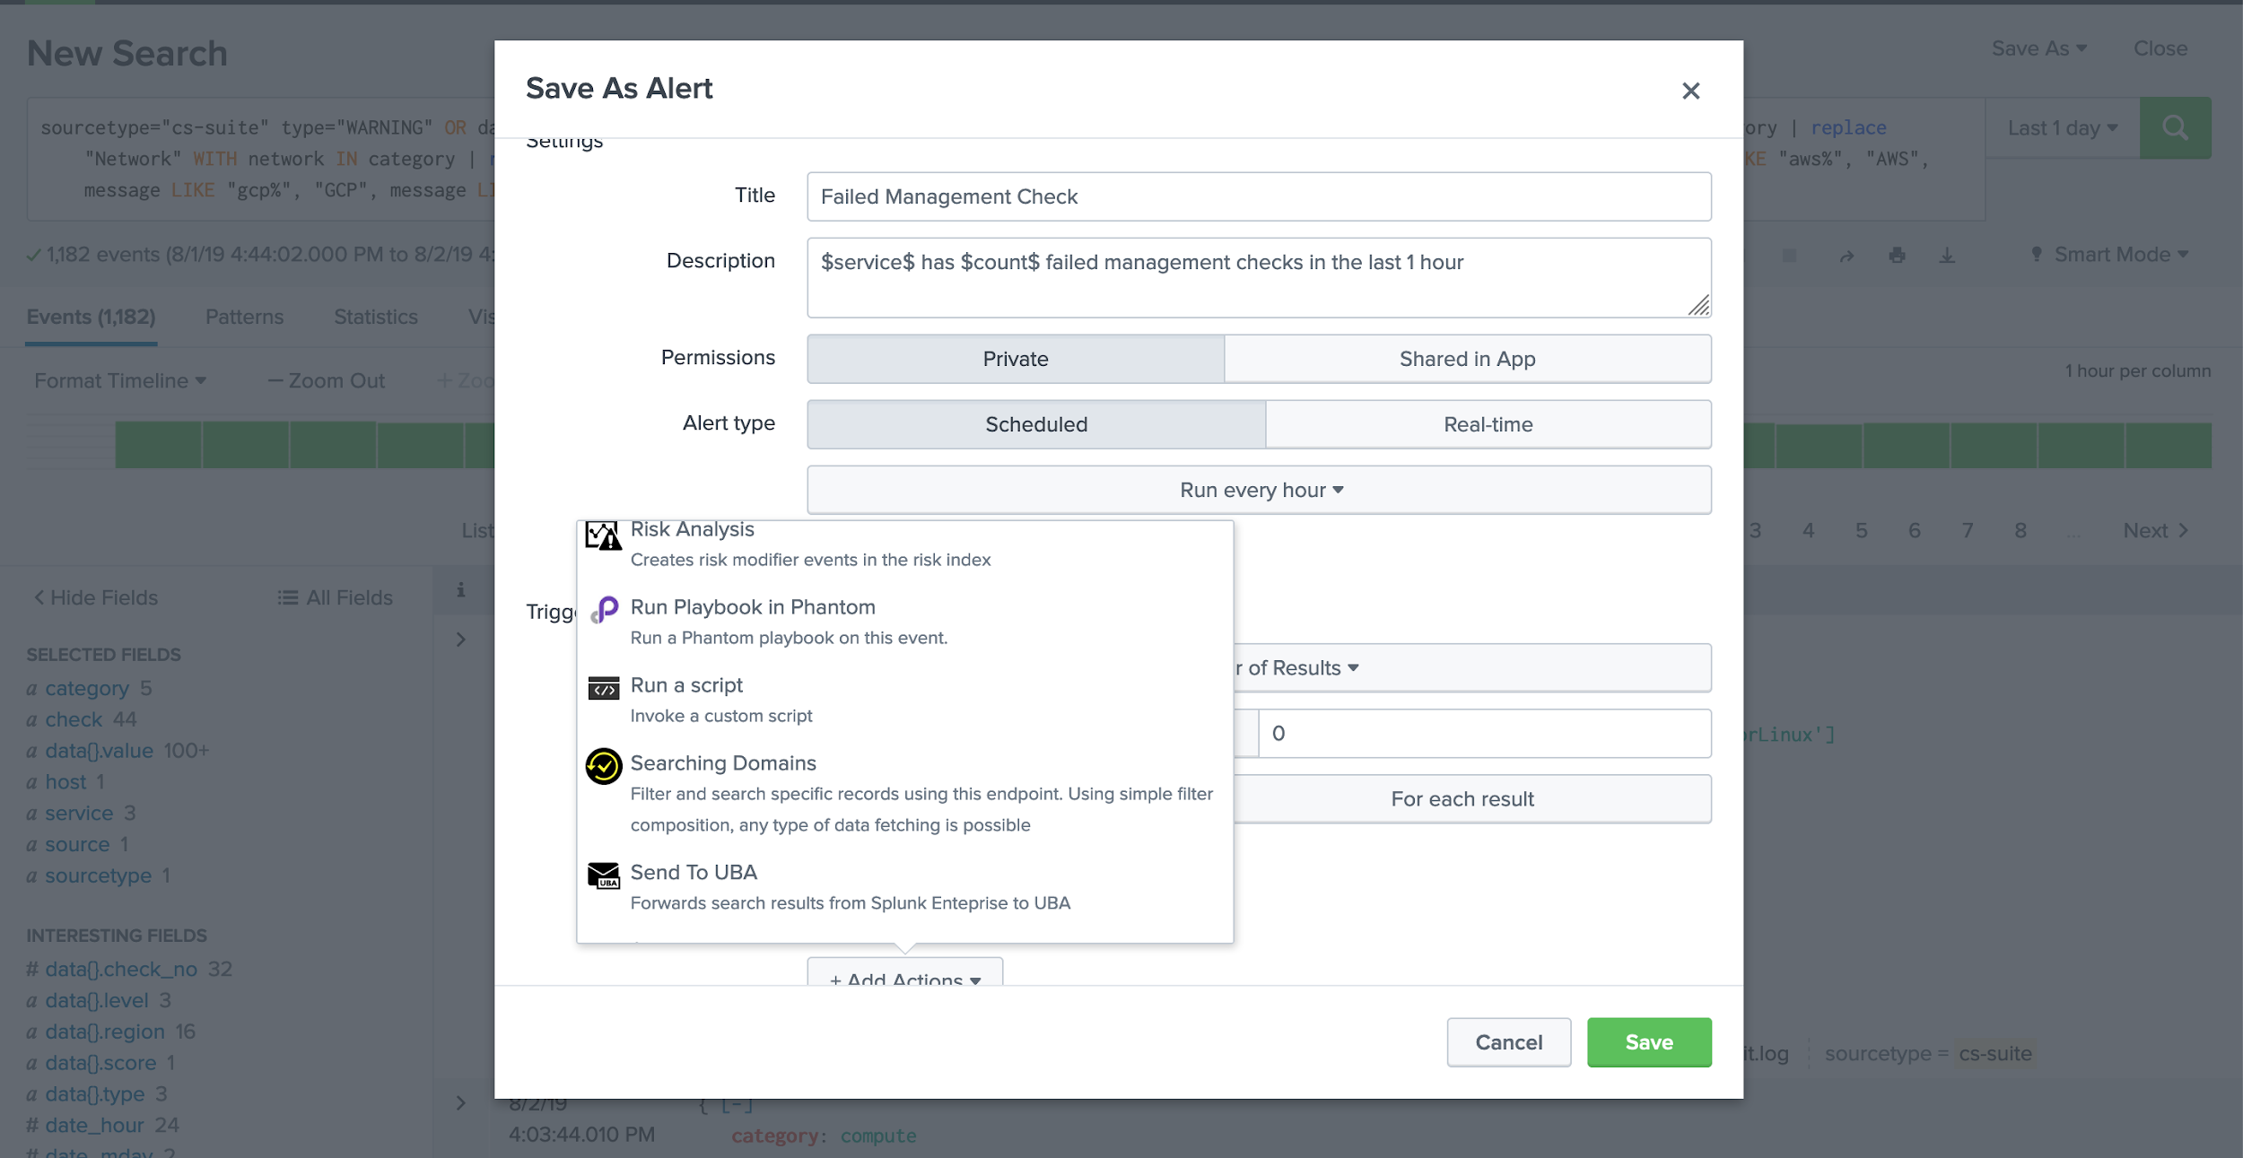
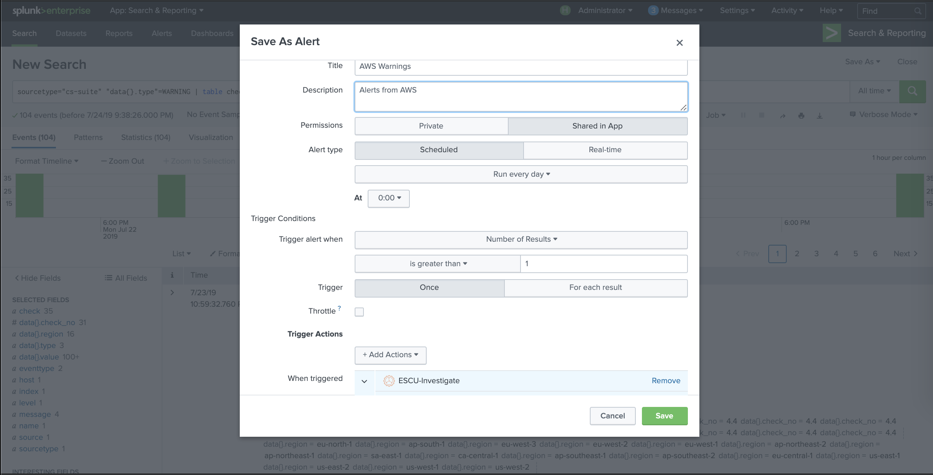
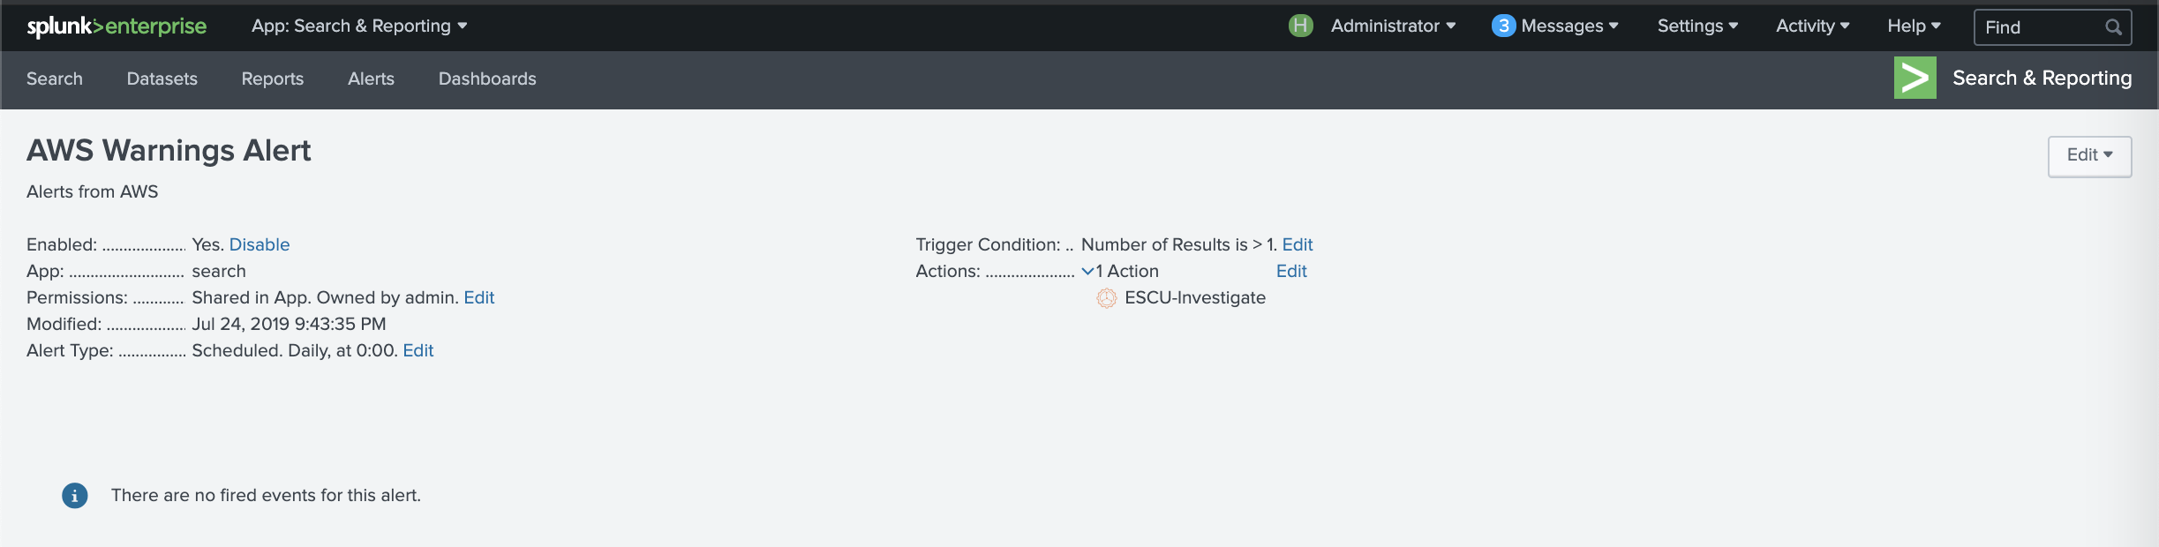
Splunk Alerts on Results

Slide 41
Q&A
Thank You!
Rod Soto @rodsoto rod@rodsoto.net
Jose Hernandez @d1vious josehelps.com

